Slide 1
Integrated Coastal Zone Management of three study areas in South America
Campuzano, F.J., Mateus, M.D., Leitão, P.C., Marín, V.H., Tironi, A., Pierini, J.O., Sampaio, A.J.P., Almeida, P., Neves, R.J.
campuzanofj.maretec@ist.utl.pt

Slide 2










Project Partners
Five universities: IST (pt), Universidad de Chile (cl), Unisanta (br), IOUSP (br), Trieste University (it).
Two institutes: LNEC (pt) and IADO (ar)
Three companies: Hidromod (pt), Noctiluca (nl) and CEA (cl)

Slide 3
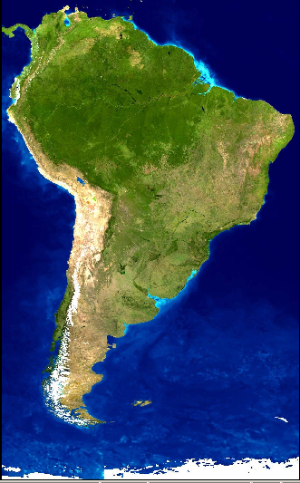
Study Sites
Santos Estuary
24ºS
Bahía Blanca Estuary
39ºS
Aysén Fjord
45ºS

Slide 4
Strategic Objectives of EcoManage
Provide interdisciplinary framework to assist on resolving conflicting uses of resources;
Coupling of models to describe the whole human-ecosystem interaction, including its physical, ecological and social parts.
To understand and quantify similarities and differences of estuarine response to anthropogenic impacts.
To provide scientifically-sound support to local environmental managers.

Slide 5
Physical-Ecological-Social system (PHES-system)
DPSIR framework The concept behind this acronym is based on a holistic approach to manage conflicts between different coastal uses and interests and to facilitate the use and dissemination of information between society, managers and scientists. This approach emphasizes the analysis of biotic and abiotic components of ecological systems and their interaction. However, in its classical form, this approach does not consider humans as components (O’Neill, 2001).
Facilitate several of the requirements of the ICZM such as: the inclusion of human societies as components of coastal zones, the integrated analysis of eco-social components and the use of conceptual models to describe the different visions held by the social actors. Conceptual participative modelling is one of the ways in which the social actors present their own perspective of an ecological system, as each actor can have their own PHES-system of an ecological system.

Slide 6
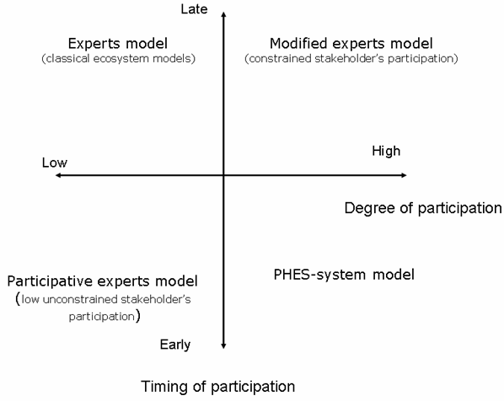
Human-ecosystem interaction.
Report on methodologies and modeling approaches
Brazil
Argentina
Chile

Slide 7
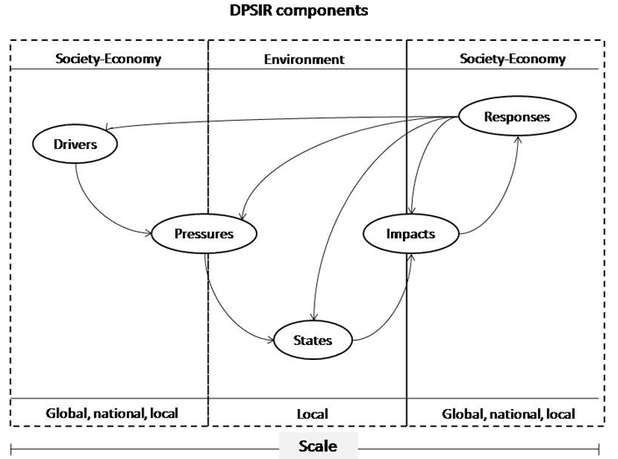
Human-ecosystem interactions.
Modelling DPSIR for all sites.

Slide 8
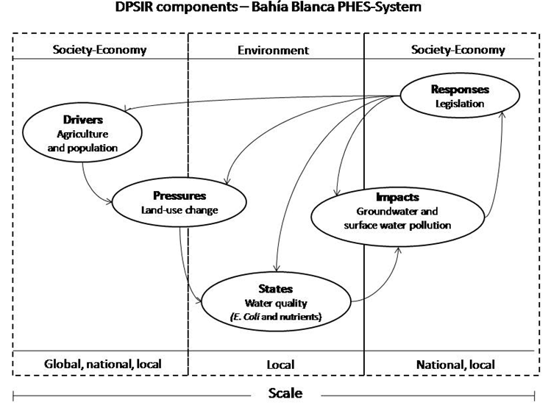

Slide 9
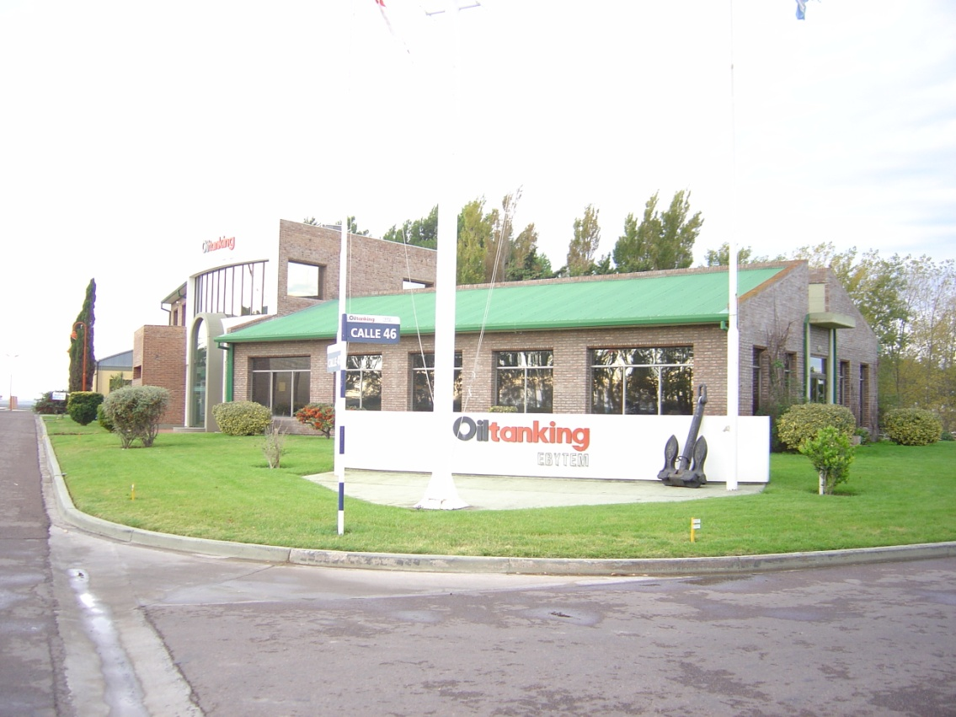
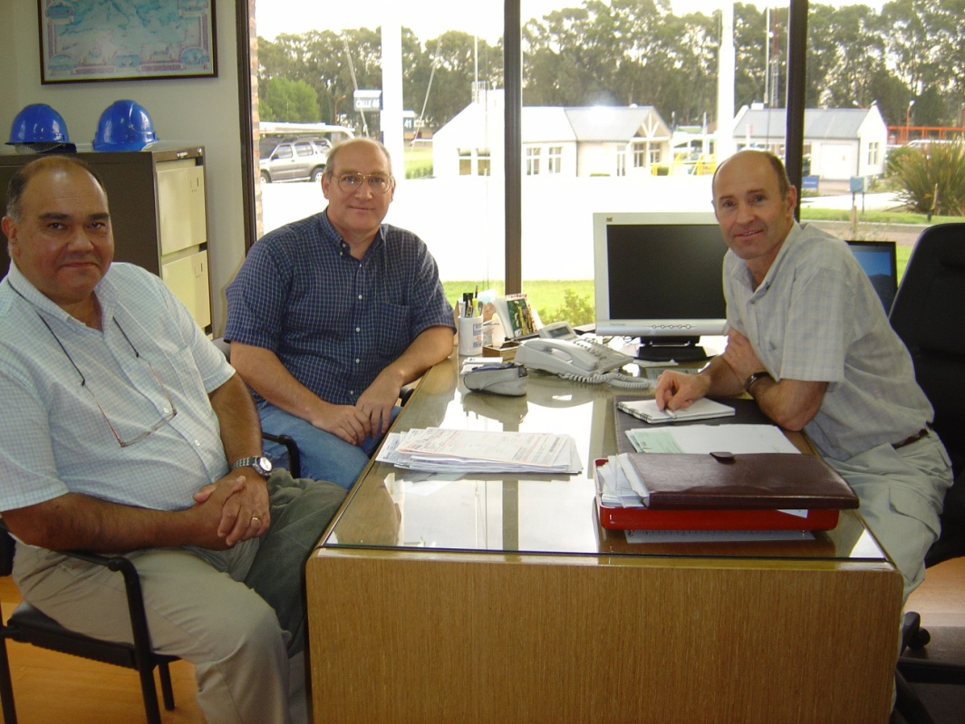
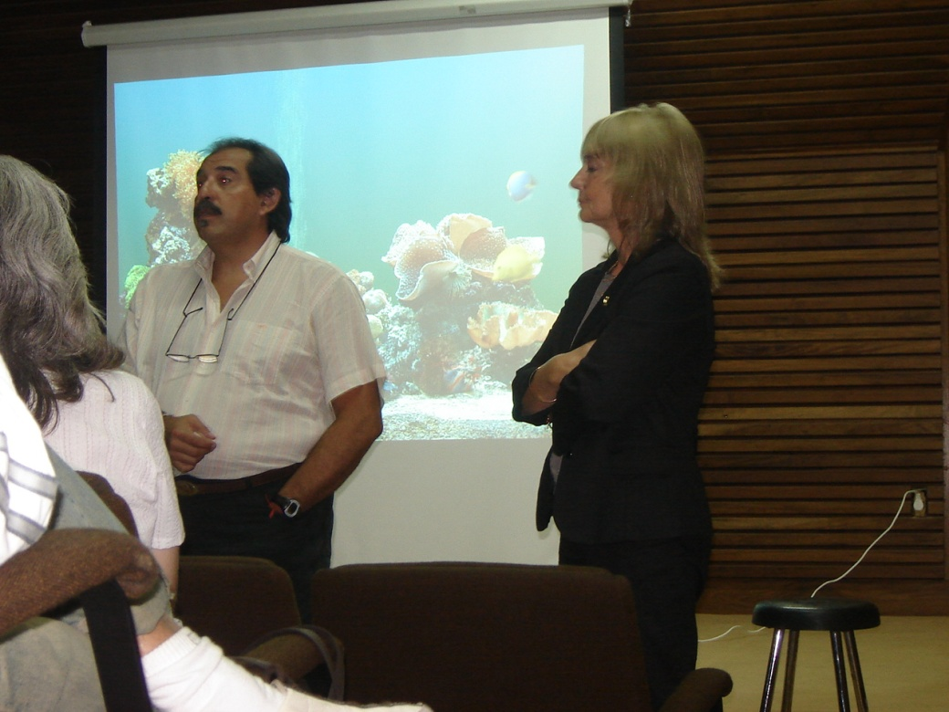


Contact with Stakeholders

Slide 10
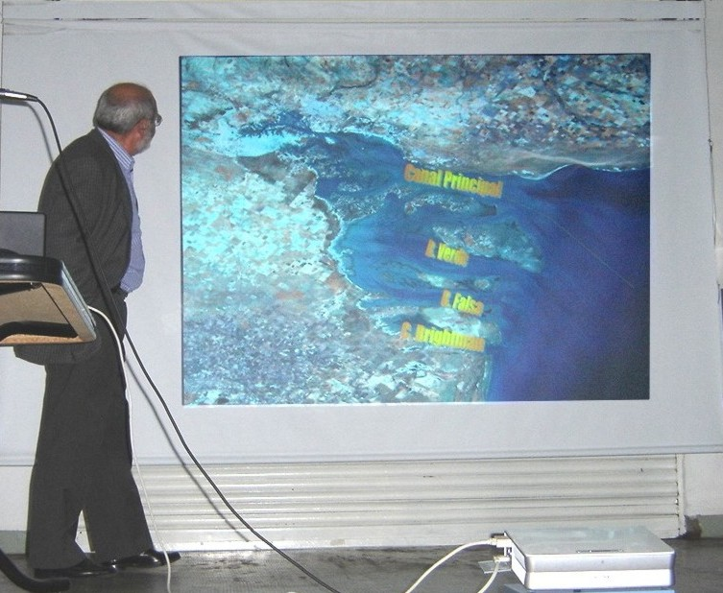
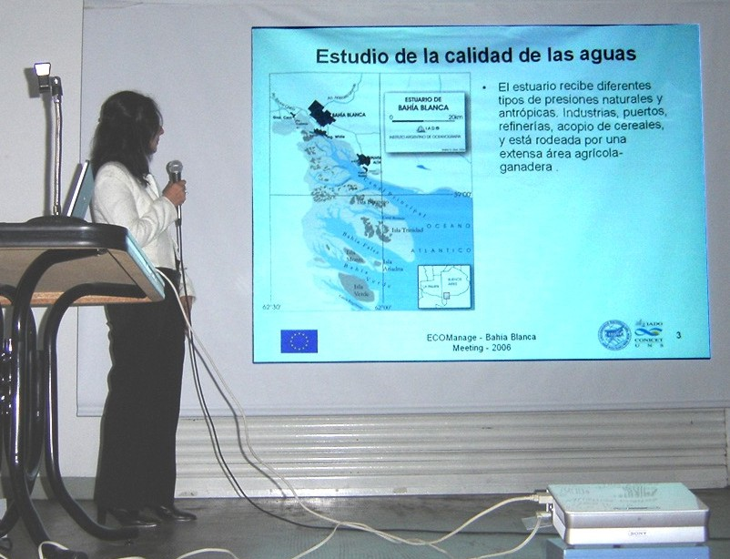
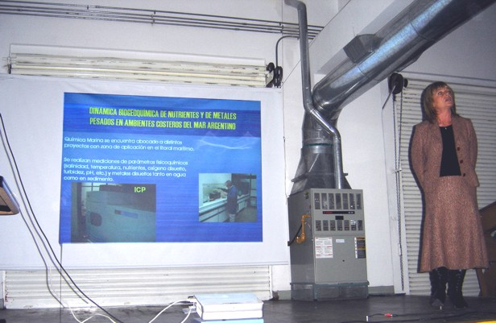
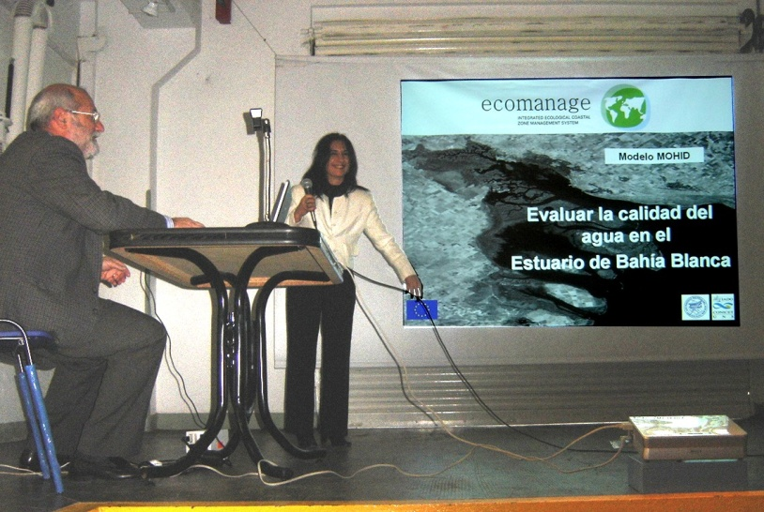
Contact with Stakeholders

Slide 11
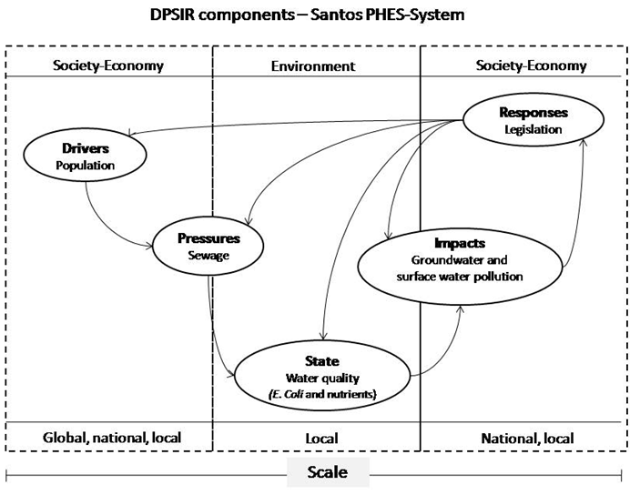

Slide 12
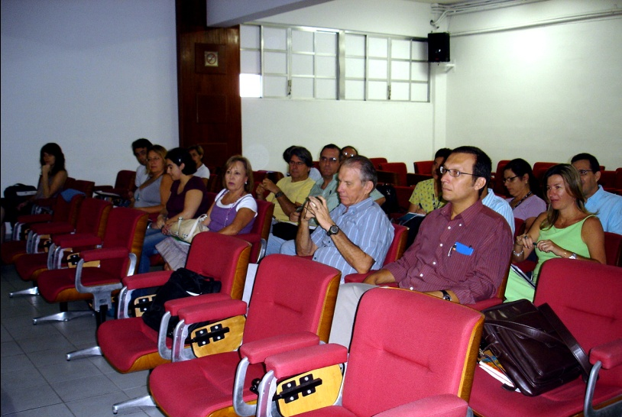
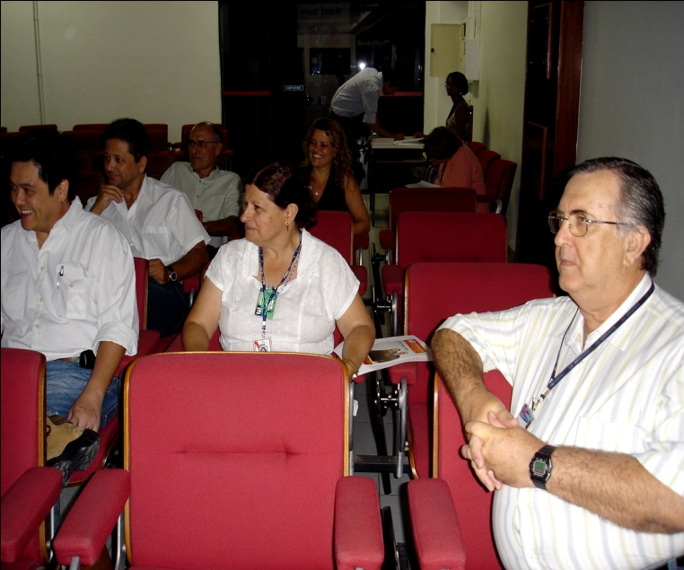
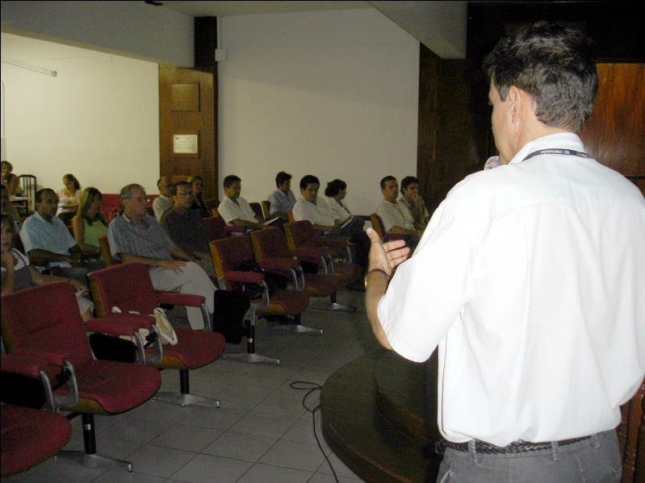
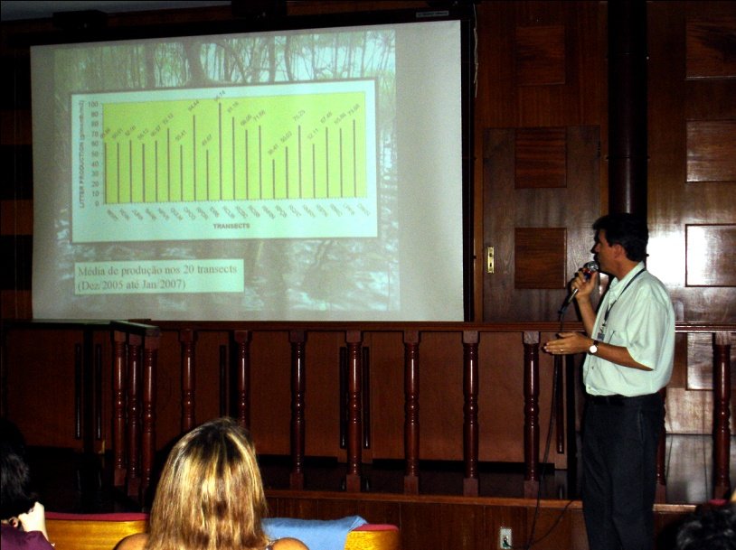
Building of the DSS: Stakeholders
Meeting in Santos

Slide 13
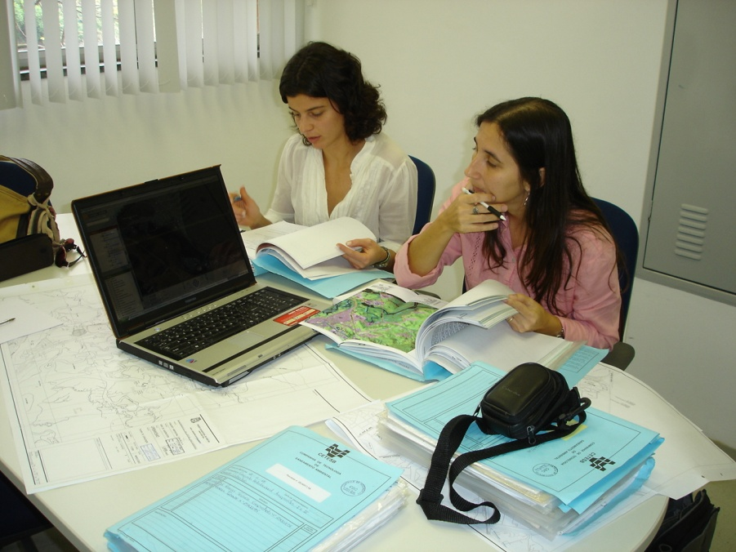
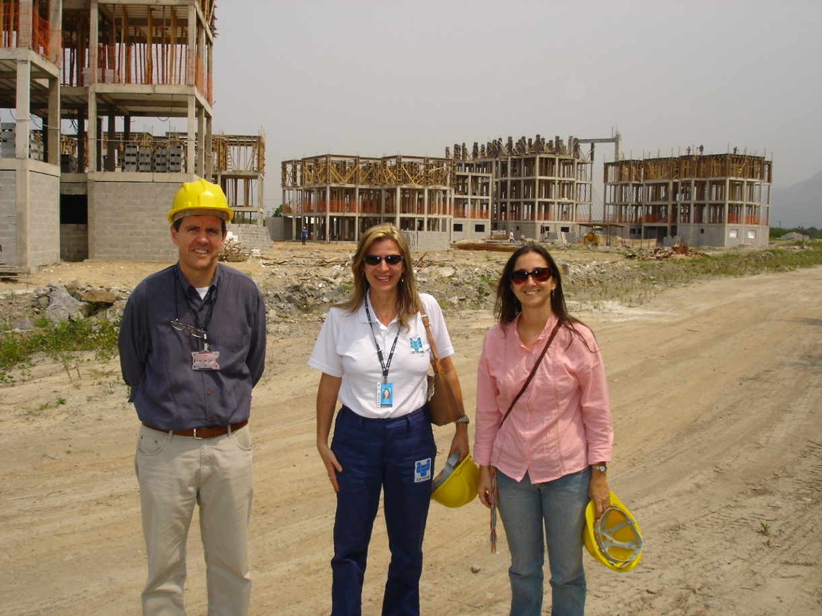
Partnership with CETESB

Slide 14
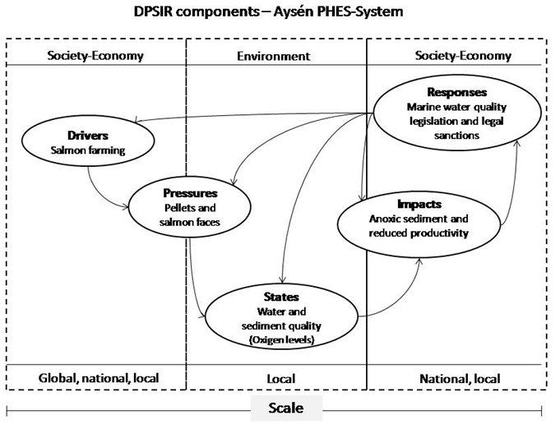

Slide 15
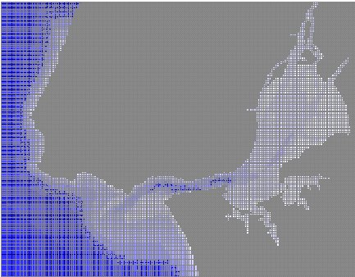
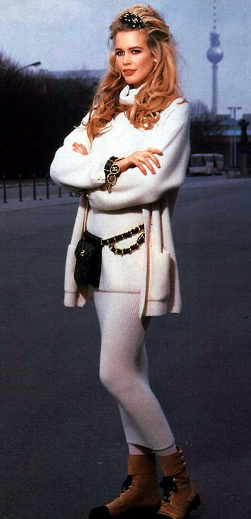

The models
Mathematical models improve with age.....

Slide 16

Surface
http://www.mohid.com
Oil processes
Water Properties
Water Quality.
Waves
Dissolved properties
Currents
Advection
Diffusion
Turbulence
http://www.gotm.net
Particulate
Properties
Módulo Interface BOTTOM
Sediment Properties
Sediment Quality.
Physical processes:
Consolidation, bioturbation
Interstitial water
Solid phase

Slide 17
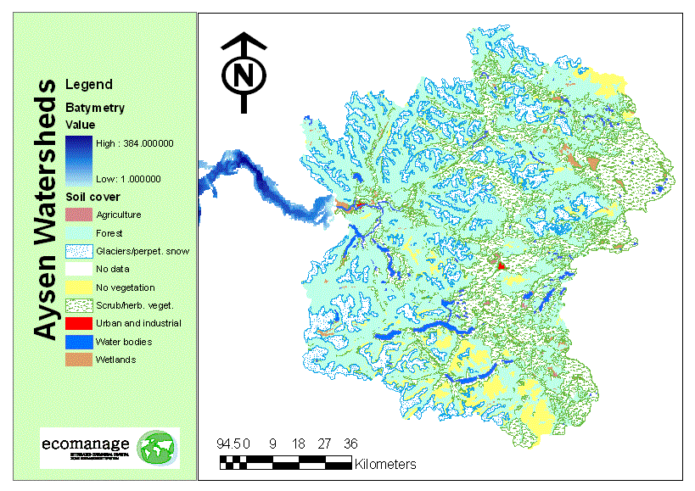
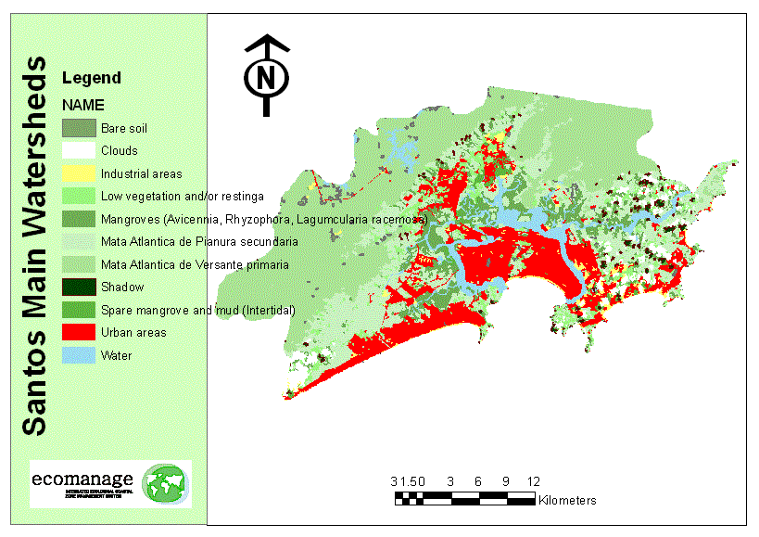
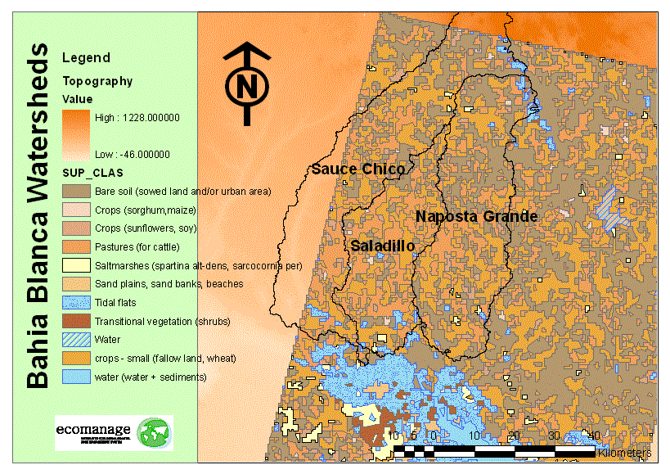
Land Use – Land Cover
IST, Lisbon September 2007
Notes:
17

Slide 18
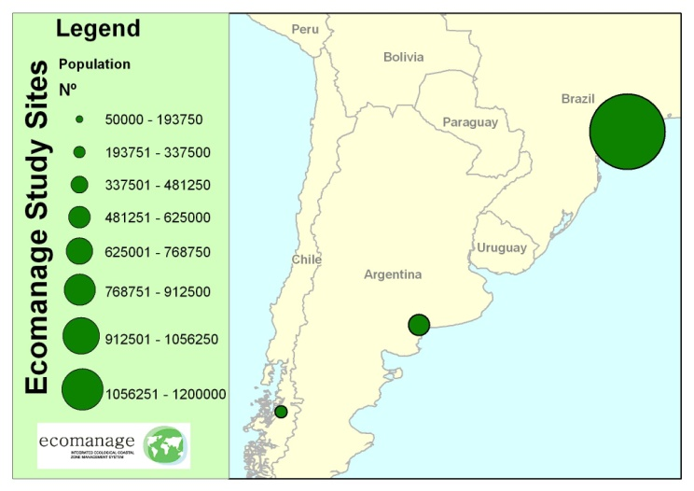
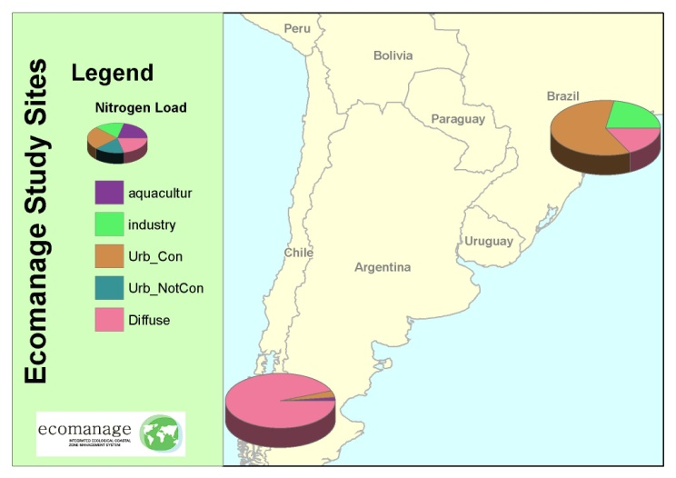
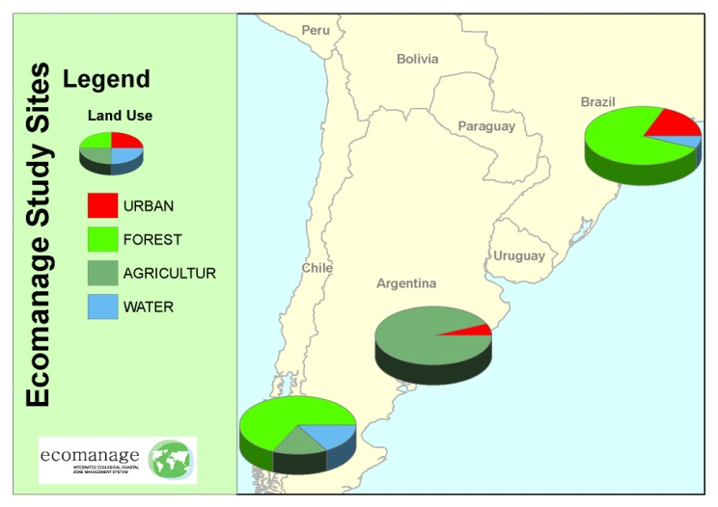
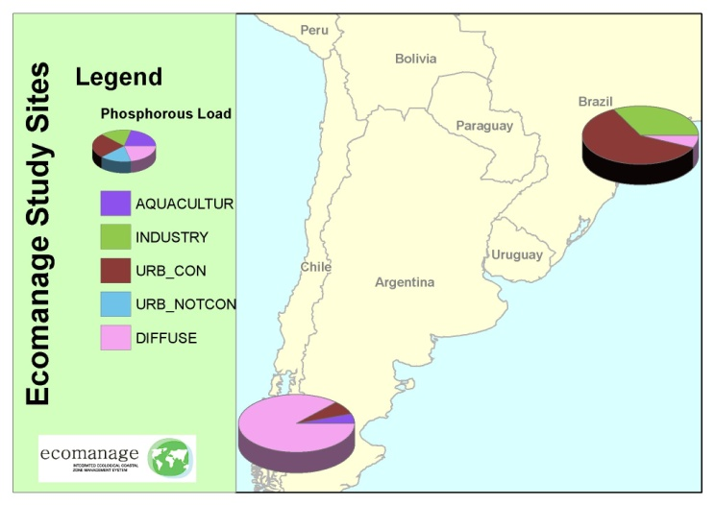
Estimation load contribution to estuary
Population and Land Use
Load Nitrogen
INPUT
OUTPUT
Land Use
Load Phosphorous

Slide 19
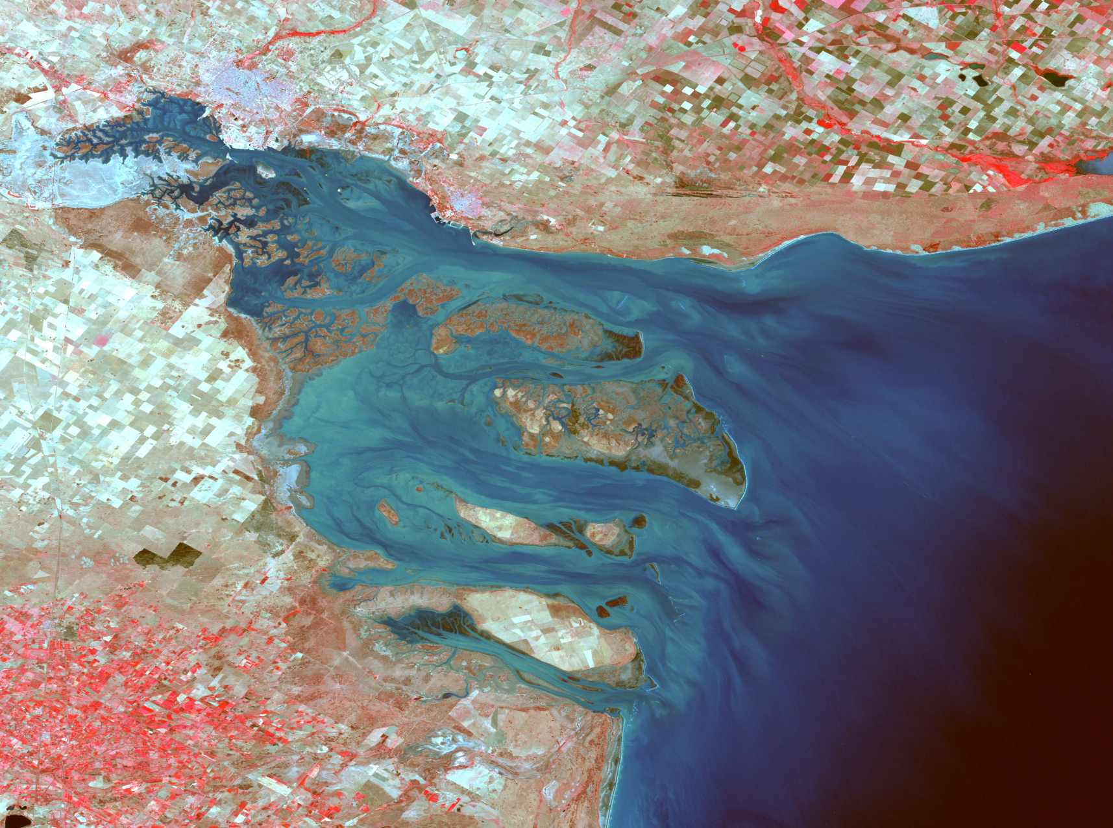
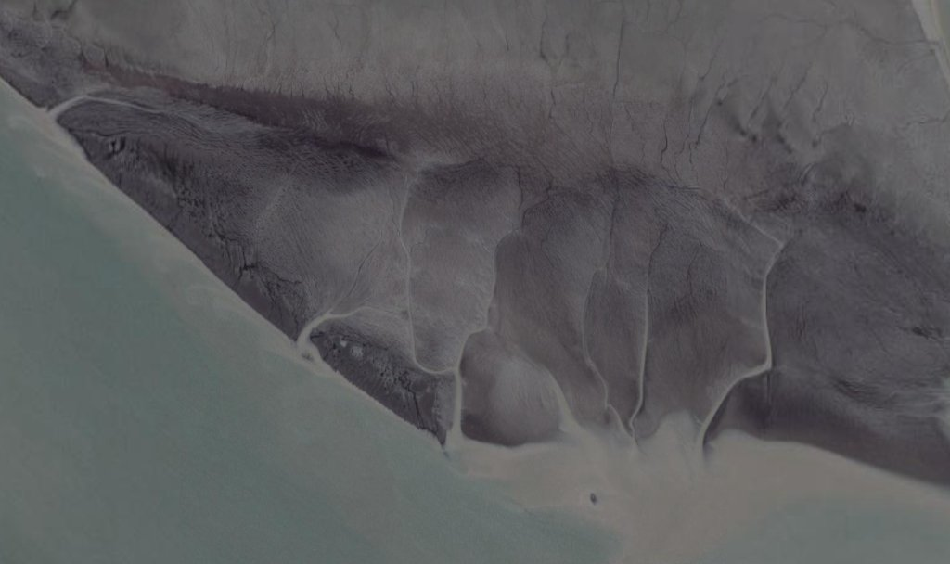
Bahía Blanca Estuary

Slide 20
Main Issues @ Bahía Blanca
Industrial & Domestic effluents,
Port Activities: dredging, origin and fate of sediments
Bathing waters,
Preservation of natural environment.

Slide 21
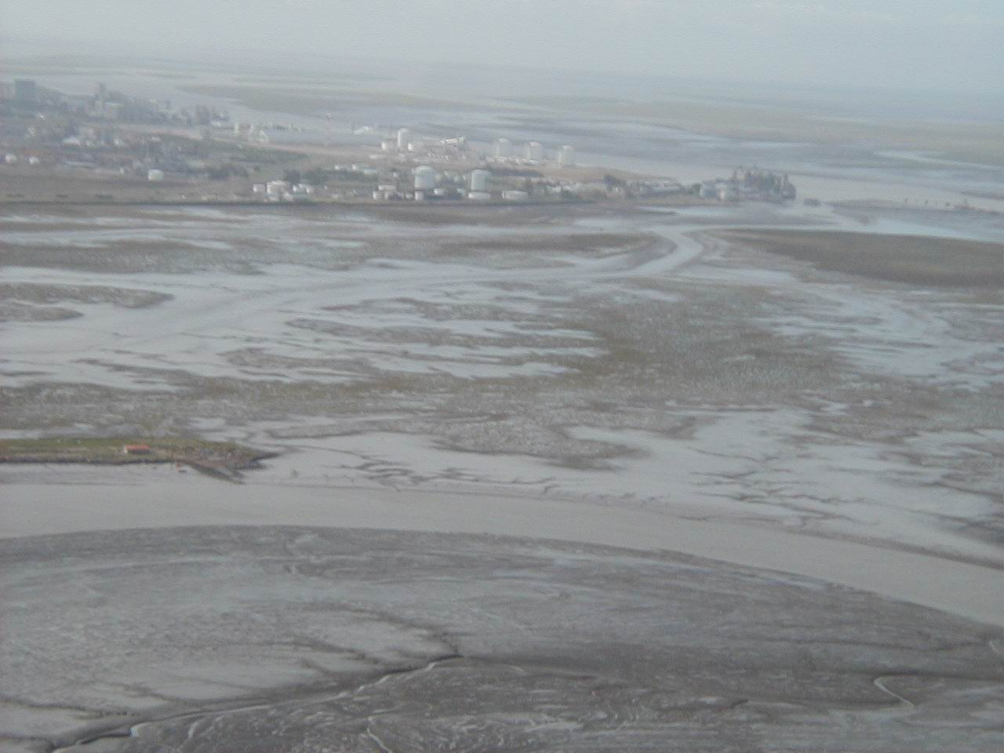
Bahía Blanca: Industrial area

Slide 22
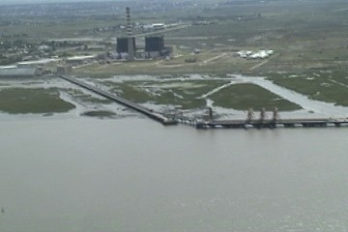
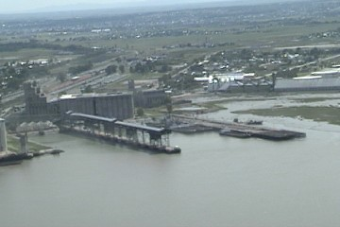
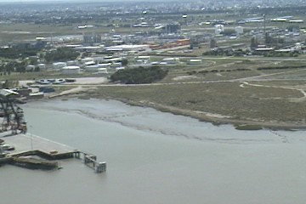
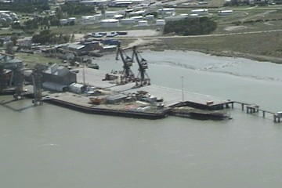
Port Facilities
Puerto Ingeniero White

Slide 23
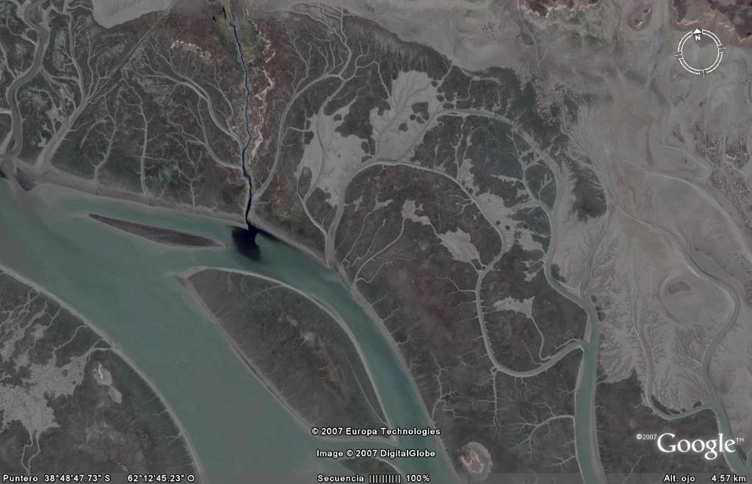
Sewage discharges

Slide 24
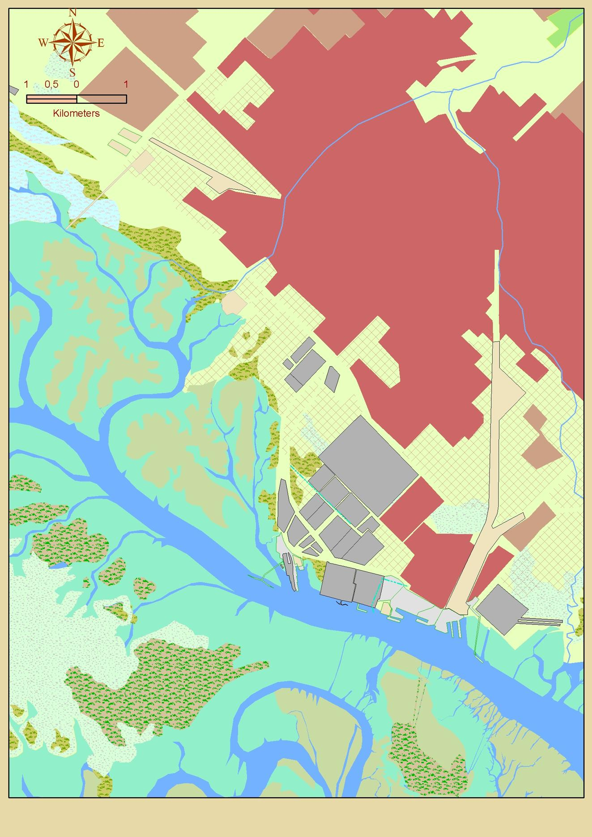

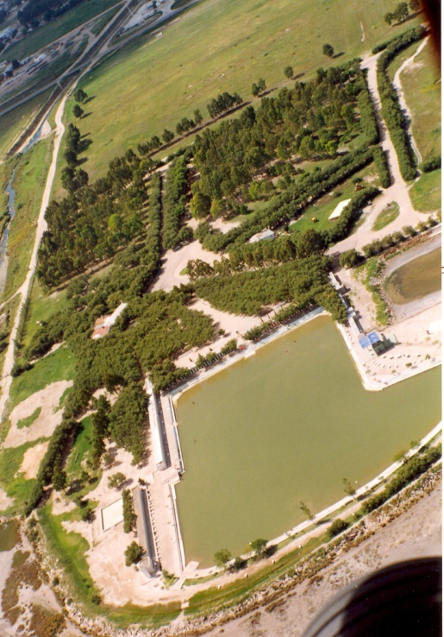

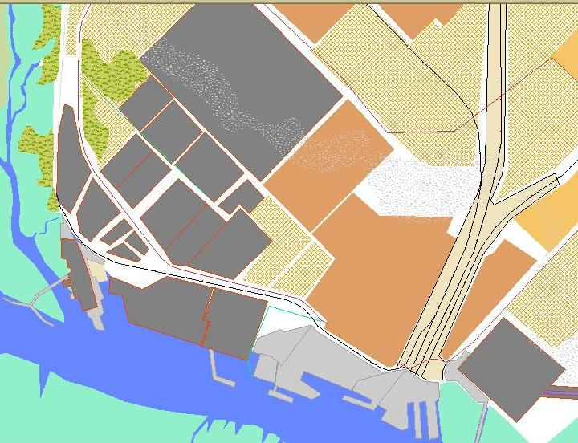


Slide 25
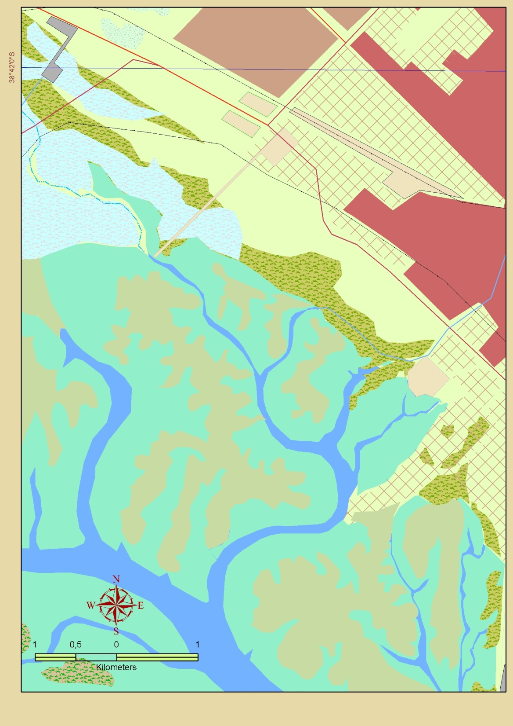
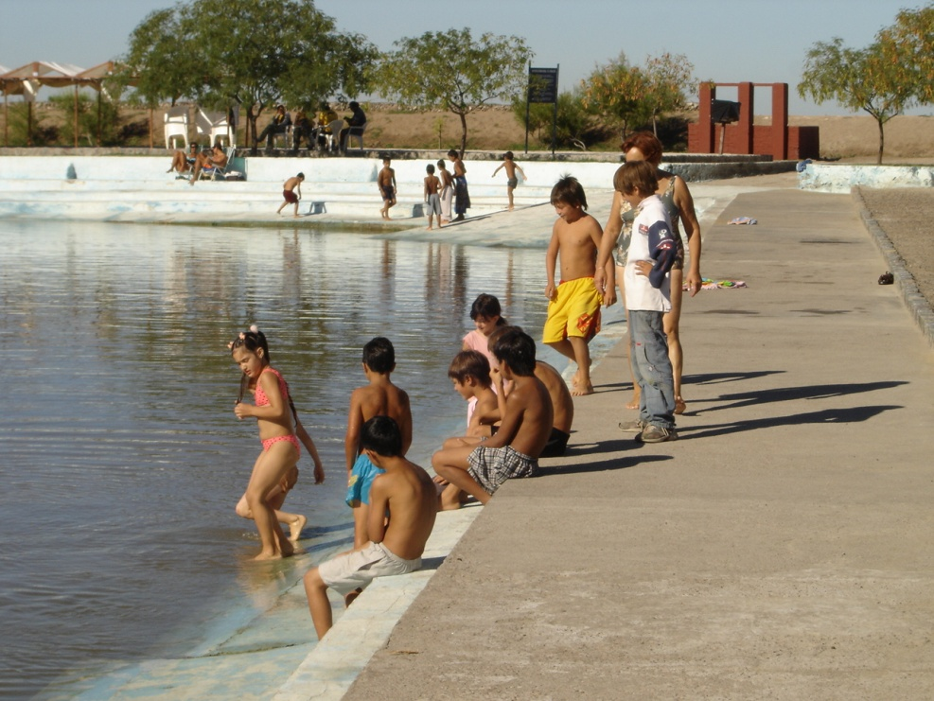

Slide 26
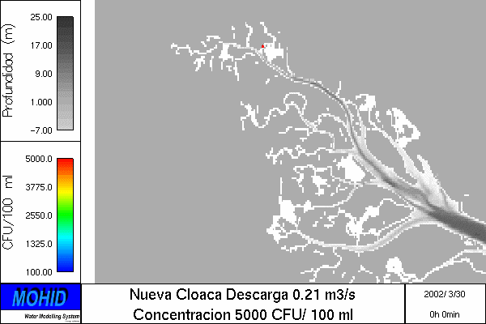
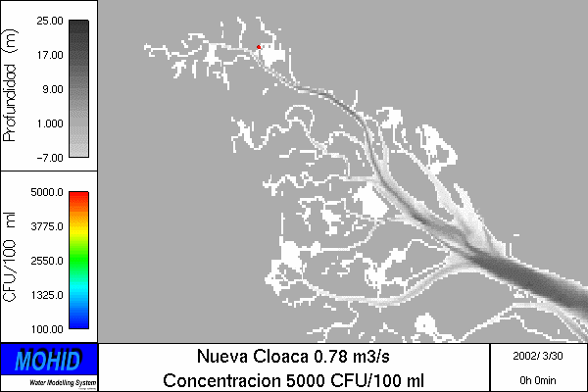
Bahía Blanca city.
New urban discharge

Slide 27
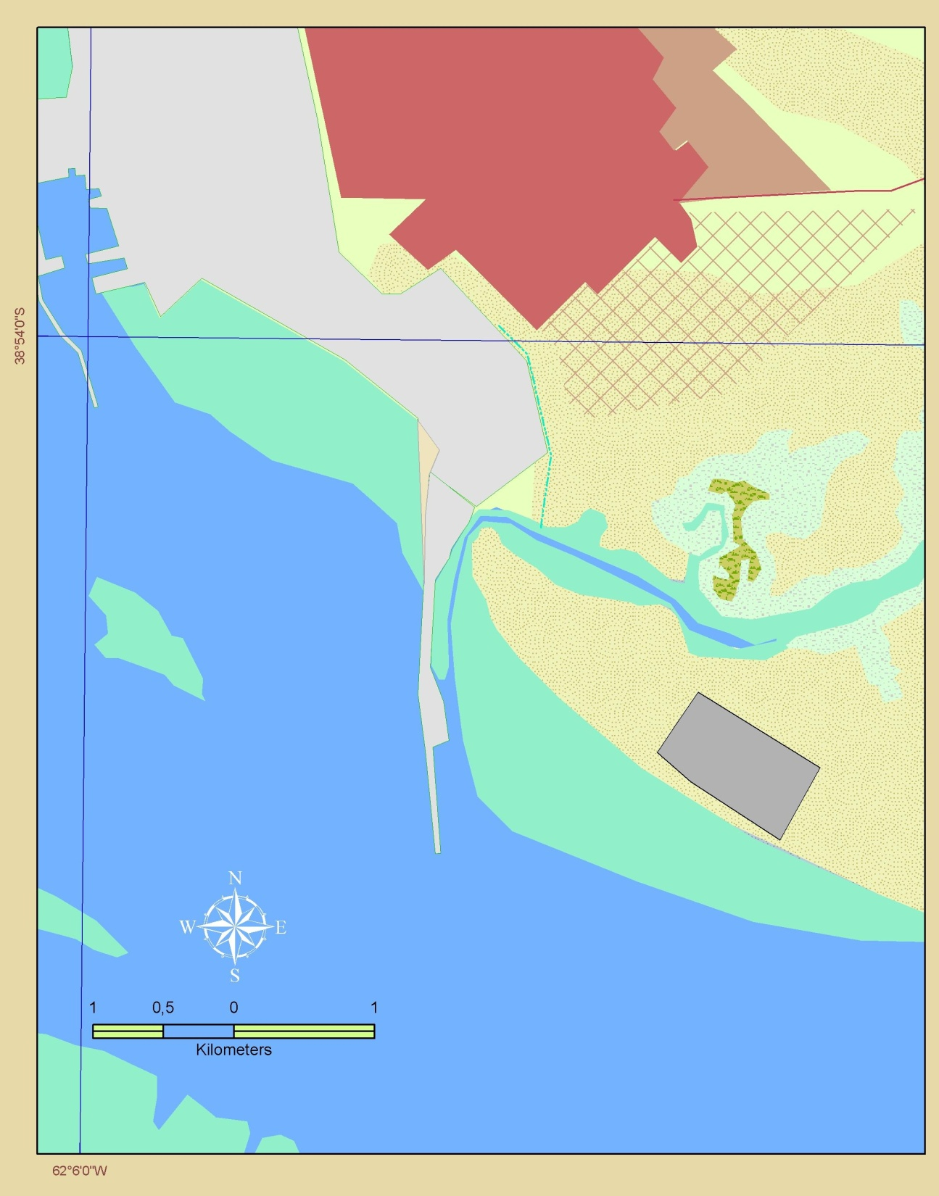
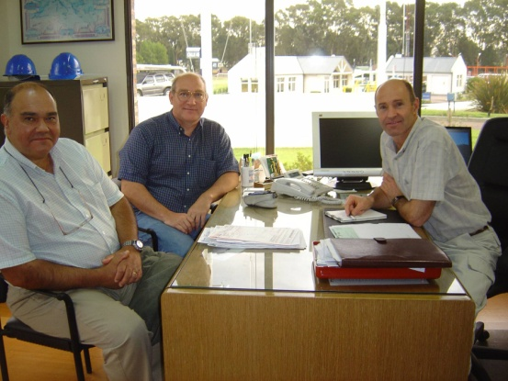
PORT ROSALES AREA
Urban discharge
FUTURE
FREE ZONE
OILTANKING
Ebytem
Oil spill

Slide 28
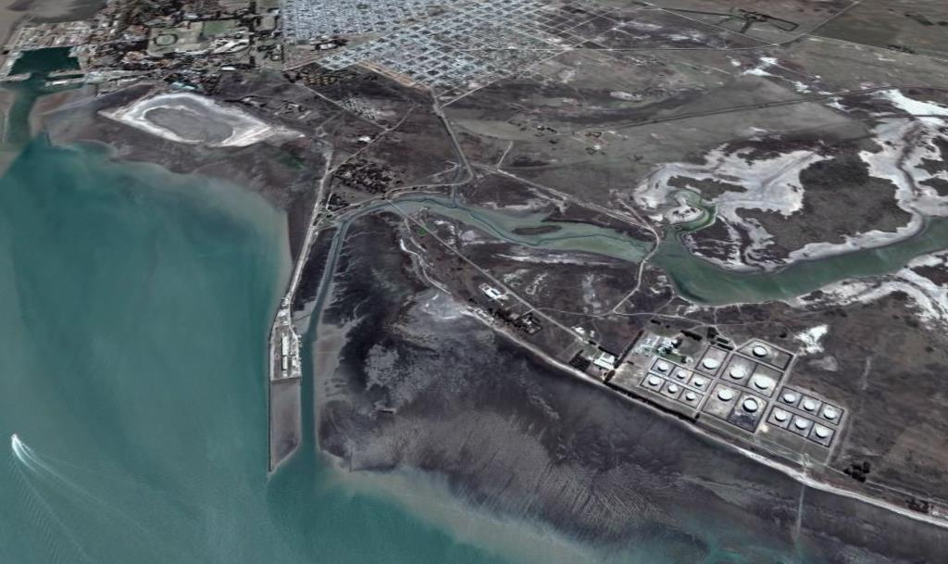
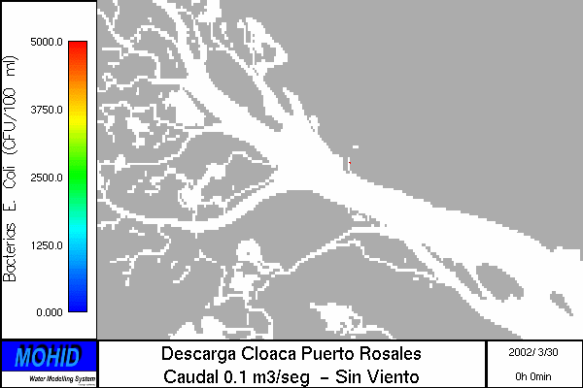
PORT ROSALES AREA

Slide 29
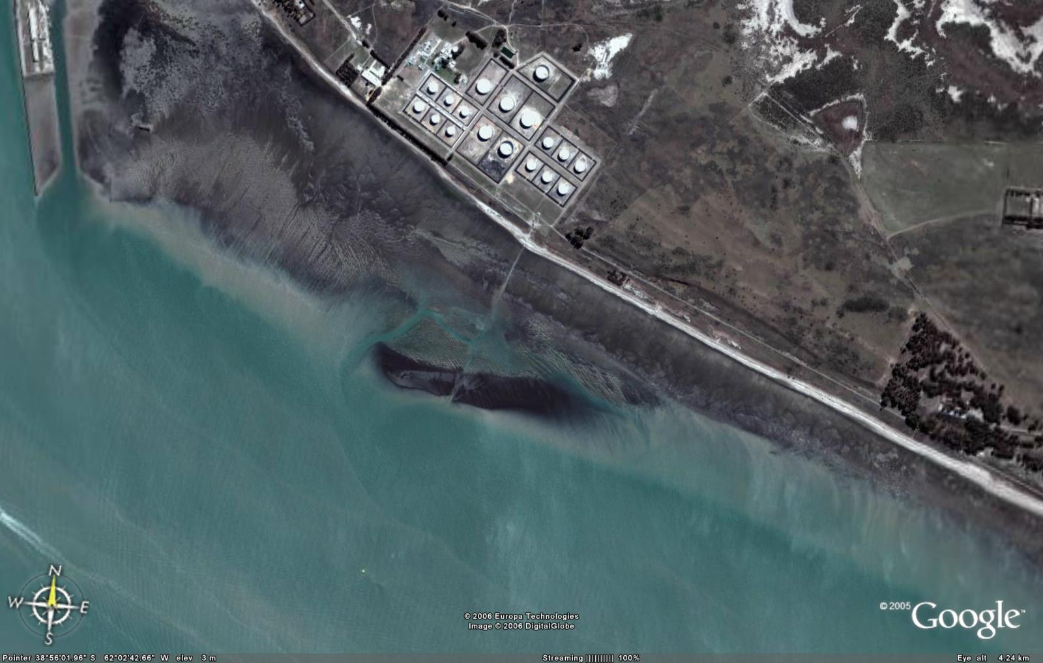

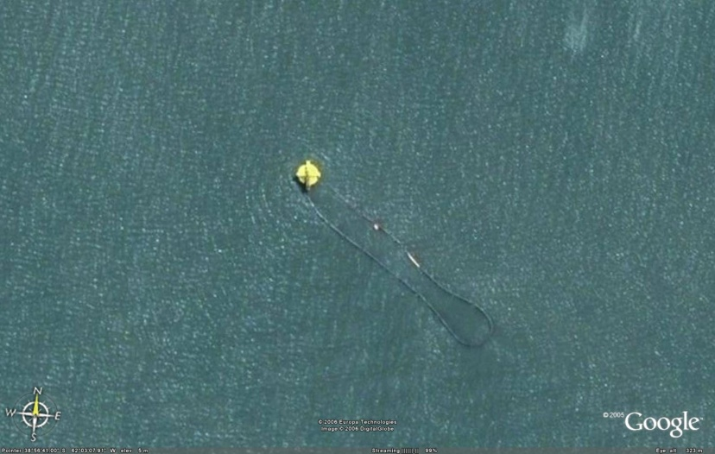
Port Rosales Area
Oil spill
Punta Cigueña

Slide 30
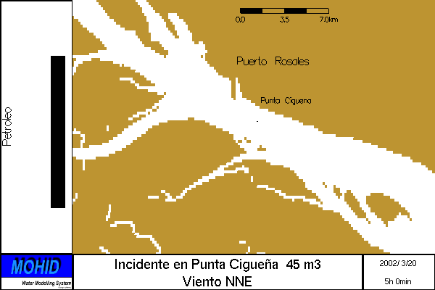



Punta Cigueña during ebb conditions

Slide 31
Santos Estuary

Slide 32
Main Issues @ Santos
Industrial & Domestic effluents;
Port Activities: dredging;
Tourism & Preservation of natural environment
Watershed management.

Slide 33





Slide 34

Detecting the pressures
Olmos & Silva 2003

Slide 35

Scenarios and MOHID

Slide 36

Coliform concentration results for the different tidal stages ( scenario 2007-2008)
First scenario - Sewage

Slide 37

Results
Pollution concentrations increased in case 2 due to an increase in population and not in the water treatment
Significant reduction of E. Coli concentrations in scenario 3 (however with values around 10E³ MPN/100ml)
Faecal pollution irradiation in nearly all the estuary with the exception of the UWWTP and outfall influence area

Slide 38

Aysén Fjord

Slide 39
Main Issues @ Aysén
Aquaculture,
Tourism & Preservation of natural environment,
Catchment management.

Slide 40





Slide 41



Modelling Strategy

Slide 42



Slide 43






Water level and current intensities

Slide 44

5 O R I G I N S

Slide 45

Areas designated according to farming industries capacity
Salmon farming not allowed
Farming allowed!

Slide 46


2007:the year of the tsunami
April 21st, 2007

Slide 47


Slide 48

Effects of the tsunami

Slide 49

Official Chilean Inundation chart for Puerto Aysén
and Puerto Chacabuco

Slide 50



Slide 51


WEB PAGE: http://ecosistemas.uchile.cl
Apache
PHP with postgresql & postgis support
mapserver with postgis support

Slide 52

MetaData Web
URL to the data included in the chosen dataset

Slide 53
Major outcomes
Identification of the main drivers and pressures
Set up, calibration and validation of numerical models
Testing development scenarios / management options with models
Stakeholders’ involvement
International, cross-disciplinary teamwork
A decision support system
The versatility of the set of tools employed in this project.
The insights that it can provide into the major physical-ecological interactions in the estuary;
Assessing the contribution of isolated Pressures such as the sewage outfall or industrial effluent to the State of the system
Provide a numerical tool to help in the management of the system (Response) by allowing the testing of different scenarios of human Pressures.

Slide 54
Conclusions
The versatility of the set of tools employed in this applications.
The insights that it can provide into the major physical-ecological interactions in the estuary
Assessing the contribution of isolated Pressures such as the sewage outfall or industrial effluent to the State of the system
Provide a numerical tool to help in the management of the system (Response) by allowing the testing of different scenarios of human Pressures.

Slide 55




Further information in
Available for download at:
www.ecomanage.info

Slide 56

Thank you very much!
Muito obrigado!
¡Muchas Gracias!

